Slide 1


PHISHING DETECTION SYSTEM
NEHRU INSTITUTE OF TECHNOLOGY
(AUTONOMOUS)
Approved by AICTE, New Delhi & Affiliated to Anna University, Chennai
Accredited by NBA ,Accredited by NAAC With A+, Recognized by UGC with section 2(f)
Kaliyapuram, Coimbatore.
DEPARTMENT OF COMPUTER SCIENCE ENGINEERING
Presented by:
AKASH K (721021104011)
AKASH N (721021104034)
PRAKASH R (721021104021) GUIDED BY:
SENTHIL KUMAR K S (721021104023) Mrs.T.Priyadharshini.

Slide 2
ABSTRACT:
This paper presents an optimized phishing detection model using machine learning to identify fraudulent websites. By analyzing URL structure, website content, and domain features, the model classifies websites as legitimate or phishing. We deploy advanced supervised learning algorithms, such as KNN to enhance accuracy and efficiency. The model is trained on a comprehensive dataset. Results show a significant reduction in detection time and improved accuracy.

Slide 3
Background Study:
Phishing is a type of cyber-attack where attackers impersonate legitimate entities to steal credentials, financial information, or other sensitive data. Traditional phishing detection methods rely on blacklists, heuristics, or user awareness, but they are often ineffective due to the evolving nature of phishing techniques.

Slide 4
Advantages:
Automated detection of phishing websites
High accuracy with proper feature selection
Reduces dependency on manual verification
Disadvantages:
Performance depends on dataset quality
May require periodic retraining to adapt to new phishing techniques
Computationally expensive for large datasets

Slide 5
Problem Identified and Confirmed:
The increasing number of phishing attacks demands a more efficient and automated approach for detecting malicious websites. Traditional rule-based methods are inadequate due to their inability to adapt dynamically. Hence, implementing a machine learning-based solution can enhance detection efficiency.

Slide 6
Objectives and Scope of the Project:
To develop an ML-based phishing detection system using the KNN algorithm.
To extract relevant features from URLs for accurate classification.
To evaluate the model's accuracy, precision, recall, and F1-score.
To create a user-friendly interface for easy phishing detection.

Slide 7
TARGET ACHIEVED TILL NOW:
We as team have gathered software tools to perform our work .
Collected our new data sets (Kaggle)
Deep background study .
Literature survey and reference.

Slide 8
Methodology:
Assumptions:
Phishing websites exhibit distinct patterns in URL structure and domain features.
Constraints and Limitations:
Model effectiveness depends on the quality and diversity of the dataset.
Potential false positives due to feature overlaps.

Slide 9
LEVERAGING MACHINE LEARNING MODELS USED PREVIOUSLY
ALGORITHM | ACCURACY
LINEAR REGRESSION | 58.8
NAÏVE BAYEES | 88.3
SVM | 71.8
GRADIENT BOOSTING MACHINE | 70.3
RANDOM FOREST | 96.7

Slide 10
MODULES:
Data collection:
Phishing and Legitimate URLs
Email Dataset
UI Interface
By using HTML CSS Bootstrap
Model Training
Deployment

Slide 11
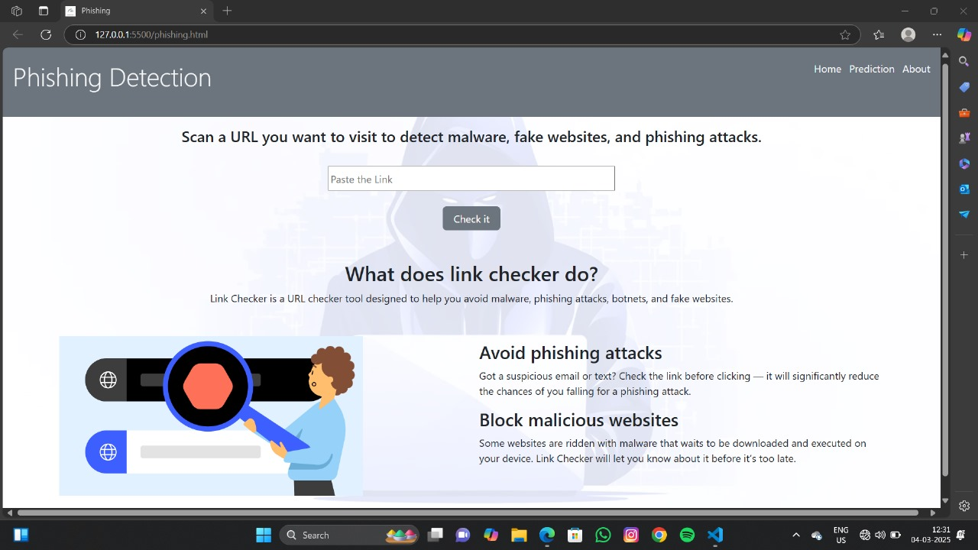

Slide 12


PLATFORMS/TOOLS:
Programming Language: Python , HTML

Slide 13




Libraries: Scikit-learn, Pandas, NumPy, Flask (for deployment), Matplotlib

Slide 14



Dataset Sources: PhishTank, UCI ML Repository, Kaggle

Slide 15
Architecture Diagram:
DATA COLLECTION
FEATURE EXTRACTION
PREPROCESSING
MODEL TRAINING
CLASSIFICATION
EVALUTION
USER INTERFACE

Slide 16
System Requirement Specification (SRS):
Hardware Requirements:
Minimum 8GB RAM, i5 Processor or above
20GB free disk space
Software Requirements:
Windows/Linux OS
Python 3.x
Required libraries (Scikit-learn, Flask, etc.)

Slide 17
Conclusion:
The proposed phishing detection system using KNN aims to enhance cybersecurity by accurately identifying malicious websites. By leveraging machine learning, this system can provide an automated, scalable, and effective solution to combat phishing attacks.

Slide 18
REFERENCE:
1.Khonji, Mahmoud & Iraqi, Youssef & Jones, Andy. (2013). Phishing Detection: A Literature Survey. IEEE Communications Surveys &amp Tutorials. PP. 1-31. 10.1109/SURV.2013.032213.00009.
2.Admassu, Tsehay. (2021). K-Nearest Neighbor Based URL Identification Model for Phishing Attack Detection. Indian Journal of Artificial Intelligence and Neural Networking. 1. 18-21. 10.35940/ijainn.B1019.041221.
3.Kayode-Ajala, O. (2022). Applying Machine Learning Algorithms for Detecting Phishing Websites: Applications of SVM, KNN, Decision Trees, and Random Forests. International Journal of Information and Cybersecurity,6(1),43–61.Retrievedfrom https://publications.dlpress.org/index.php/ijic/article/view/41
4. T. Wu, S. Liu, J. Zhang, and Y. Xiang, ‘‘Twitter spam detection based on deep learning,’’ in Proc. Australas. Comput. Sci. Week Multiconf., Jan. 2017, pp. 1–8.
5. M. Ribalta, R. Bejar, C. Mateu, and E. Rubión, ‘‘Machine learning solutions in sewer systems: A bibliometric analysis,’’ Urban Water J., vol. 20, no. 1, pp. 1–14, 2023, doi: 10.1080/1573062X.2022.2138460.

